Slide 1



ASP.NET Essentials – Part 2
ASP.NET MVC
Introduction
SoftUni Team
Technical Trainers
Software University
http://softuni.bg

Slide 2
Have a Question?
sli.do #CSharpWeb

Slide 3
Table of Contents
Routing using attributes
Binding POST data

Slide 4

ASP.NET MVC Routing

Slide 5
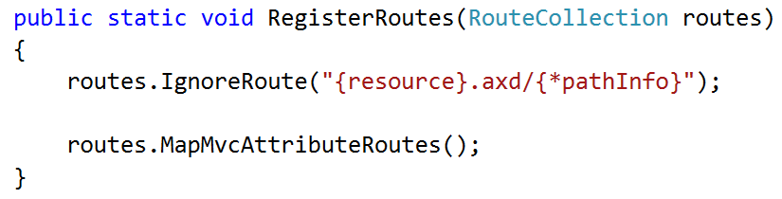
Enable routing using attributes
You need to call the method MapMvcAttributeRoutes() of the routes in the RouteConfig.cs

Slide 6
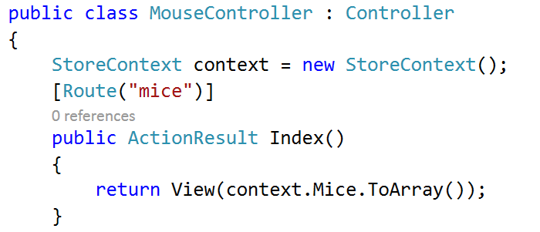
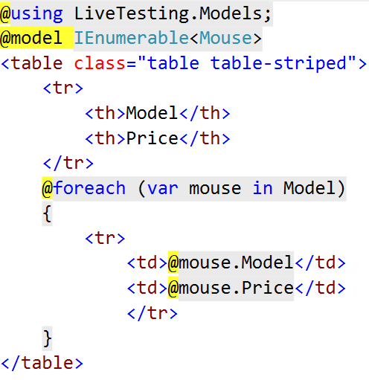
The Route attribute
Controller
View

Slide 7
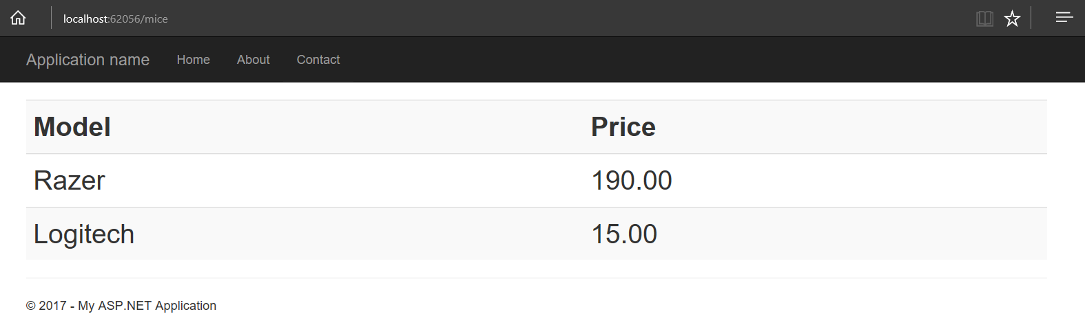
The previous results in:

Slide 8
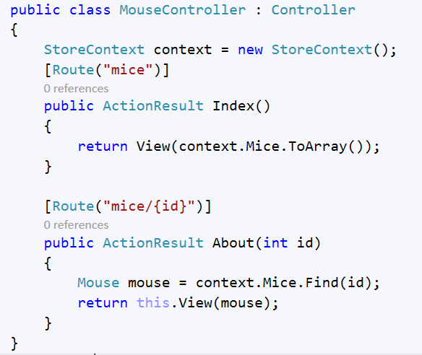
Route prefixes
Often, the routes in a controller all start with the same prefix. For example:

Slide 9
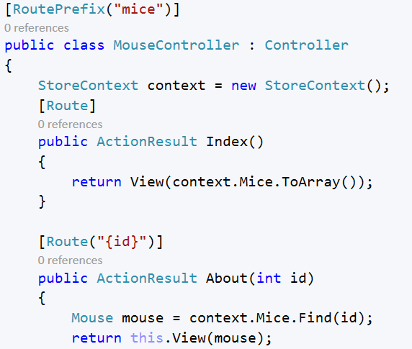
Route prefixes (2)
Here route prefixes come in handy.

Slide 10
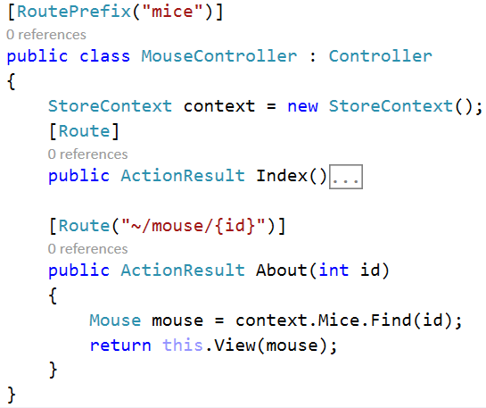
Route prefixes (3)
Use a tilde (~) on the method attribute to override the route prefix if needed:

Slide 11
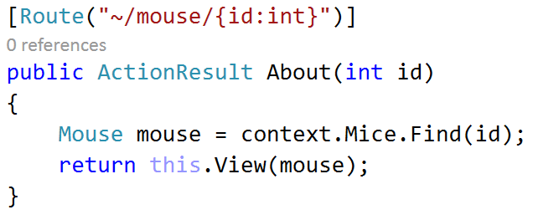
Route Constraints
Route constraints let you restrict how the parameters in the route template are matched. The general syntax is {parameter:constraint}. For example:

Slide 12
Constraints
Constraint | Description | Example
int | Matches a 32-bit integer value. | {x:int}
length | Matches a string with the specified length or within a specified range of lengths. | {x:length(6)} {x:length(1,20)}
long | Matches a 64-bit integer value. | {x:long}
max | Matches an integer with a maximum value. | {x:max(10)}
maxlength | Matches a string with a maximum length. | {x:maxlength(10)}
min | Matches an integer with a minimum value. | {x:min(10)}
minlength | Matches a string with a minimum length. | {x:minlength(10)}

Slide 13
Constraints(2)
Constraint | Description | Example
alpha | Matches uppercase or lowercase Latin alphabet characters (a-z, A-Z) | {x:alpha}
bool | Matches a Boolean value. | {x:bool}
datetime | Matches a DateTime value. | {x:datetime}
decimal | Matches a decimal value. | {x:decimal}
double | Matches a 64-bit floating-point value. | {x:double}
float | Matches a 32-bit floating-point value. | {x:float}
guid | Matches a GUID value. | {x:guid}
Regex | Matches regular expression | {x:regex(“”)}

Slide 14
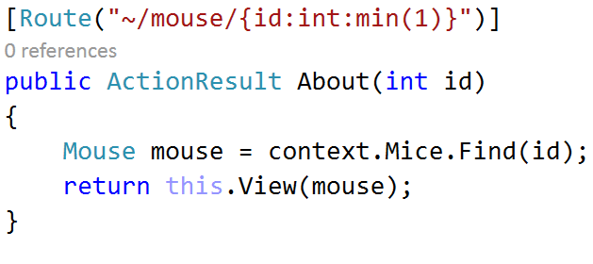
Route Constraints
You can apply multiple constraints to a parameter, separated by a colon, for example:

Slide 15
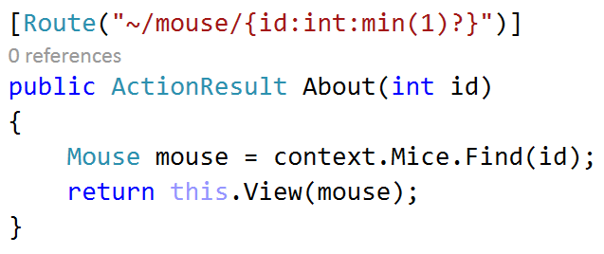
Route Constraints
Specifying that a parameter is Optional (via the ‘?’ modifier) should be done after inline constraints:

Slide 16
Route names
You can specify a name for a route, in order to easily allow URI generation for it. For example, for the following route:
you could generate a link using Url.RouteUrl:

Slide 17

Model binding

Slide 18
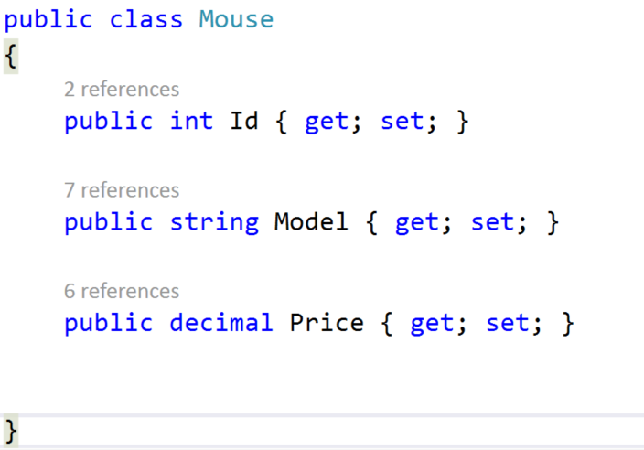
Binding using the Bind attribute
One way of binding your form data to a (binding) model is using the Bind attribute and giving it the names of your incoming data

Slide 19
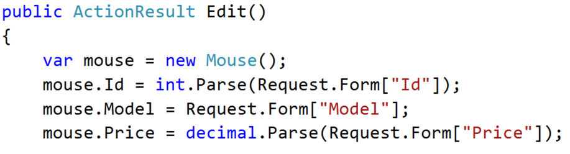
Binding using the Request.Form
Another way to get the parameters that come from in the input form is through the property Form of the Request property of the Controller

Slide 20
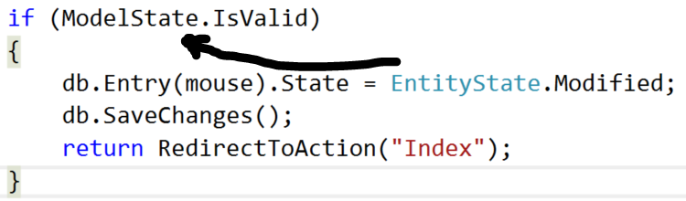
ModelState
When we receive some data from a form and bind it to a model, we need to check for the following
This way we are sure that all constraints that are applied to the model are checked before we modify it’s entity state.

Slide 21








ASP.NET Essentials – Part 2
https://softuni.bg/courses/

Slide 22
License
This course (slides, examples, demos, videos, homework, etc.) is licensed under the "Creative Commons Attribution-NonCommercial-ShareAlike 4.0 International" license

Slide 23






Free Trainings @ Software University
Software University Foundation – softuni.org
Software University – High-Quality Education, Profession and Job for Software Developers
softuni.bg
Software University @ Facebook
facebook.com/SoftwareUniversity
Software University @ YouTube
youtube.com/SoftwareUniversity
Software University Forums – forum.softuni.bg

